Slide 1


2024-2025 NSCAS Growth Spring Test Administration Training
February 2025
Notes:
Welcome to the NSCAS Growth Spring 2024-2025 Test Administration Training. This training will provide an overview of the NSCAS Growth assessments as well as instructions for how to set up and administer these assessments.

Slide 2

Testing Time and Scheduling Recommendations
Grade Level | Content Area | Approximate number of test questions | Estimated test taking time
3–8 | Mathematics | 45 | 90 minutes
3–8 | English Language Arts | 45 | 90 minutes
5 | Science | 38-41 | 60 minutes
8 | Science | 39-41 | 60 minutes
Districts/Schools have flexibility in scheduling tests
  Testing times are M–F, 6:00am to 7:00pm CT.
  Recommendation – end testing by 5:00pm CT on Fridays.
Recommendation: One to two sittings each for ELA and Math
    Schools may schedule two sessions per subject as a local decision, especially for the lower grade levels.
Notes:
For the Spring test administration, NSCAS Growth Math and ELA will have 45 questions. The estimated test taking time for both Math and ELA will be 90 minutes. NSCAS General Science grade 5 will have between 38-41 questions and grade 8 will have between 39-41 questions. The NSCAS General Science assessments should take students approximately 60 minutes. Districts have flexibility in scheduling these tests during the testing window. Tests can be taken Monday through Friday, 6:00 AM to 7:00 PM Central Time. We also recommend ending testing by 5 PM Central Time on Fridays. We recommend one to two settings each for ELA and for math, but schools may schedule 2 sessions per subject as a local decision, especially for the lower grade levels.

Slide 3
NSCAS Overview
Test Windows
Spring: March 24-May 2, 2025
  Make-up window: April 28-May 2, 2025
  AMO: March 10, 2025-May 1, 2025
Modes of Delivery:
Paper/Pencil and Braille assessments are available to order. See part 4 of the Assessment Coordinator's Guide on specific steps regarding managing paper/pencil assessment and materials.
Notes:
The Spring test window opens on March 24 through May 2, 2025. The make-up window is April 28 through May 2, 2025. This is the time for make-up tests only. The Additional Material Orders window is March 10, 2025 through May 1, 2025. The assessment delivery types for NSCAS Growth include online and paper-pencil tests. Paper forms can be requested via the NSCAS Growth system and will be sent through the sFTP to the District Assessment Contact. Braille is shipped out to the District Assessment Contact through the Material Orders Report.

Slide 4
Testing Time and Scheduling -
Recommendations and Considerations
Estimated test taking time does not include:
  Test ticket distribution.
  Launching the secure browser.
  Student log in.
Students’ tests can be paused by logging out.
Students will be automatically logged out of the test after 15 min of inactivity.
  Note: No Proctor action required for the student to resume testing, students must log back in using the information on the test ticket.
Notes:
Please keep in mind that the estimated test taking time does not include test ticket distribution, launching the secure browser application, or students logging in. Students can pause their tests by logging out, and students will automatically be logged out after 15 minutes of no activity. Please note, students can log back in with their test ticket if they're resuming a paused test.

Slide 5
Technology Readiness
Notes:
Next we will discuss technology readiness

Slide 6

Technology Readiness
NWEA State Solutions Secure Browser
System Requirements
  The Secure Testing Browser or App is REQUIRED for all devices.
  https://securebrowser.state.nwea.org
  Different STB than MAP Growth – "NWEA State Solutions Secure Browser“.
Device and Application
Mac Secure Testing Browser
Windows Secure Testing Browser
Chromebook App
iPad App
Notes:
As with prior administrations, the NSCAS Growth NWEA state solutions secure browser must be installed on all student devices prior to testing. This is a different application than the MAP Growth testing app and is represented with a blue icon. The latest version can be downloaded from the website and it's available for Mac, Windows, Chromebooks, and iPads.

Slide 7
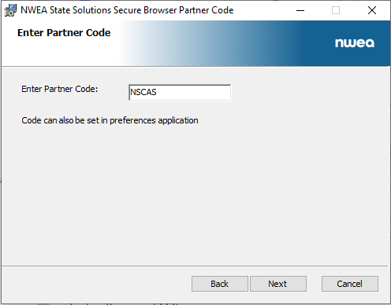
Tips for Installing the Secure Browser
Partner Code: NSCAS.
Multiple Device Management installation available.
Secure Browser can be downloaded from Acacia Manage or via the NWEA link.
Note: If a previous version has been installed, it must be uninstalled before installing the new version.
Instructions for network/MDM uninstallation in System & Technology Guide.
Reminder: Turn off auto updates on student devices during the Test Administration Window
Notes:
When installing, there will be a prompt to enter a partner code for this assessment. The partner code is NSCAS as shown on the screen. This can also be done in bulk using the instructions in the System and Technology Guide. Please keep in mind that if a previous version of the secure browser is installed, it must be uninstalled before the new version is installed. This can also be done in bulk by following the System and Technology Guide. We recommend everyone turn off Automatic Updates on student devices during the test administration window.

Slide 8
Supported Devices & Operating Systems
NWEA State Solutions Secure Browser
Device | Supported OS Versions
Windows PC | Windows 10: Versions 21H2 and 22H2 Windows 11: Versions 21H2, 22H2, and 23H2 NOT Supported: Windows 10S, 11S, 11 SE
Mac OS | 13 and 14 (older systems may work with Acacia but are not supported by Apple and NWEA Partner Support will not be able to troubleshoot any issues that arise)
Chromebook | Release Channel Only – version 119 or later
iPads | iOS 16 and 17
Notes:
Supported devices and operating system versions are as follows: for Windows, Windows 10 and 11 are supported. Windows 10S, 11S, and 11 SE are not supported; for Mac, macOS 13 and 14 are supported; for Chromebooks, we recommend being on the latest version from the official release channel, but we support version 119 or later; for iPads, iOS 16 and 17 are supported for educators and staff. No application is required, and all work can be done from a web browser.

Slide 9
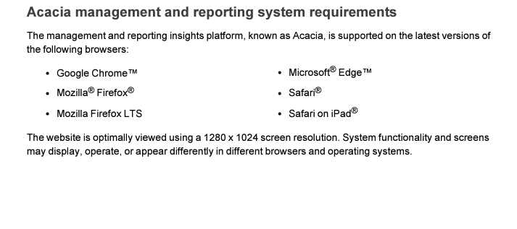
Supported Devices
Minimum system requirements for Proctors, Teachers, and Staff
System functionality and screens may display, operate, or appear differently in different web browsers. Internet Explorer is no longer supported.
Notes:
Please ensure you're using the latest version of one of the browsers above. Also note that Internet Explorer is not supported.

Slide 10
Technology Readiness
System and Technology Guide
  Navigating the NSCAS Growth Platform (Acacia)
  IT Readiness
  Network and System Requirements
  State Solution Secure Browser installations
Online Readiness Check
  Upon launching the secure browser
  Additional site available for checks
Notes:
The NSCAS Growth System and Technology Guide covers the following: Navigating the NSCAS Growth Platform, also known as Acacia; IT Readiness, Network and System Requirements, and State Solution Secure Browser Installations. The Online readiness check helps schools plan for testing.

Slide 11
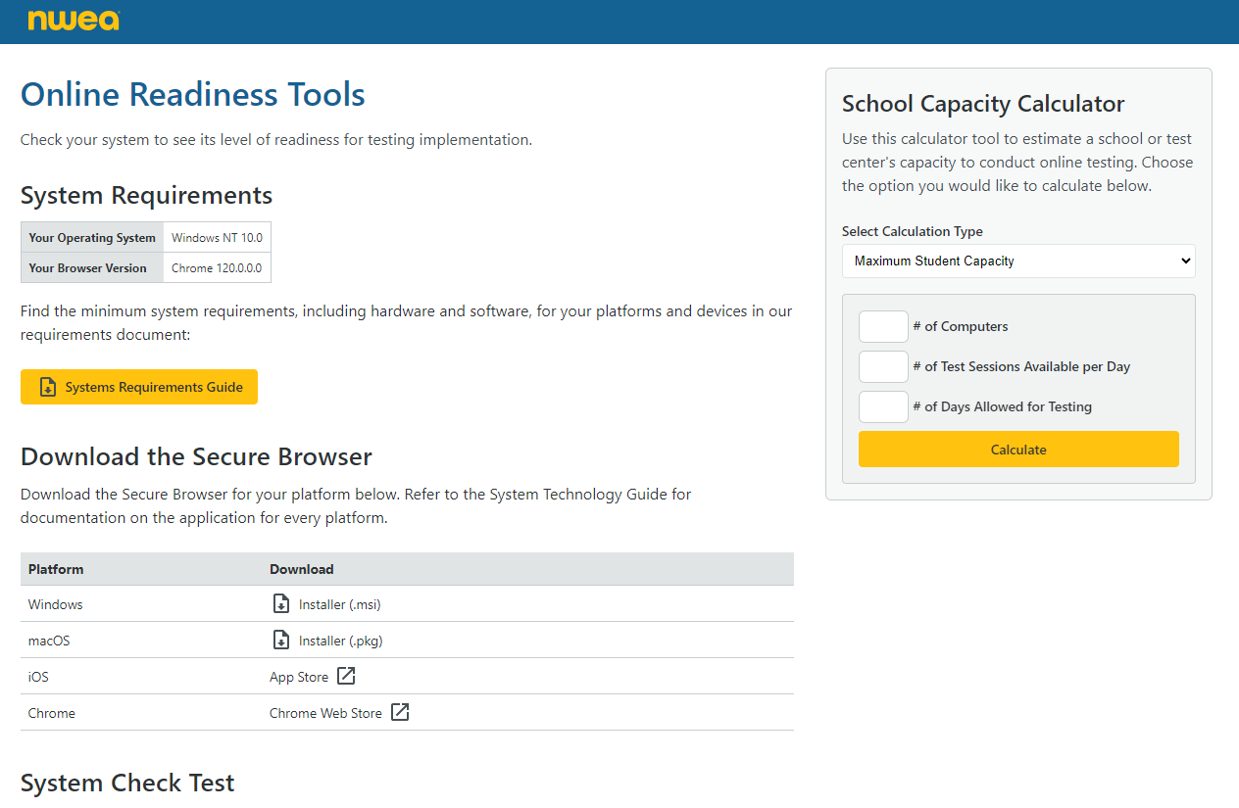
Online Readiness Checker
Resource: Online Readiness Checker
Location: https://securebrowser.state.nwea.org
Notes:
The online readiness checker allows districts and schools to check devices for compatibility here on the secure browser download page. The system requirements document is available, as well as downloads for each version of the application on the right. There's a school capacity calculator to help you plan for bandwidth usage while testing, as well as a speed test further down the page.

Slide 12
NSCAS Growth Assessment Management
(Acacia Platform)
Notes:
Next up, we will cover managing NSCAS Growth assessments in our state assessment platform, known as Acacia.

Slide 13
NSCAS Management
(Acacia)
Single-sign on connects your access from the Comprehensive Assessment Platform (MAP Growth) to the NSCAS Growth Platform (Acacia).
  Use the same MAP Growth Username / Password.
  User roles will be managed through CAP.
  Same role titles in CAP and the NSCAS Platform, different permissions.
  After logging into CAP, users will see the NSCAS link.
Notes:
As with prior NSCAS administrations, users are still managed using MAP growth. This means you'll use that same username and password that you have been using or that you use for map growth testing. User roles and permissions are also managed through the MAP Growth system known as the Comprehensive Assessment Platform or CAP. After logging in, there will be a link to the NSCAS growth assessments and then you can access the Acacia platform.

Slide 14
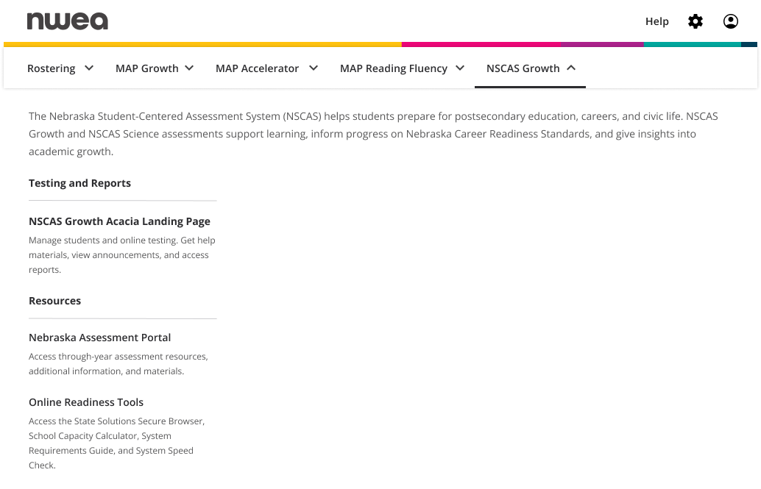
NSCAS Management
(Acacia)
Notes:
When you login, you'll see the NSCAS growth link along the top. Once you click that, you can click on the other highlighted link NSCAS Growth Acacia Landing Page. From there you'll be in Acacia where you can manage NSCAS assessments.

Slide 15
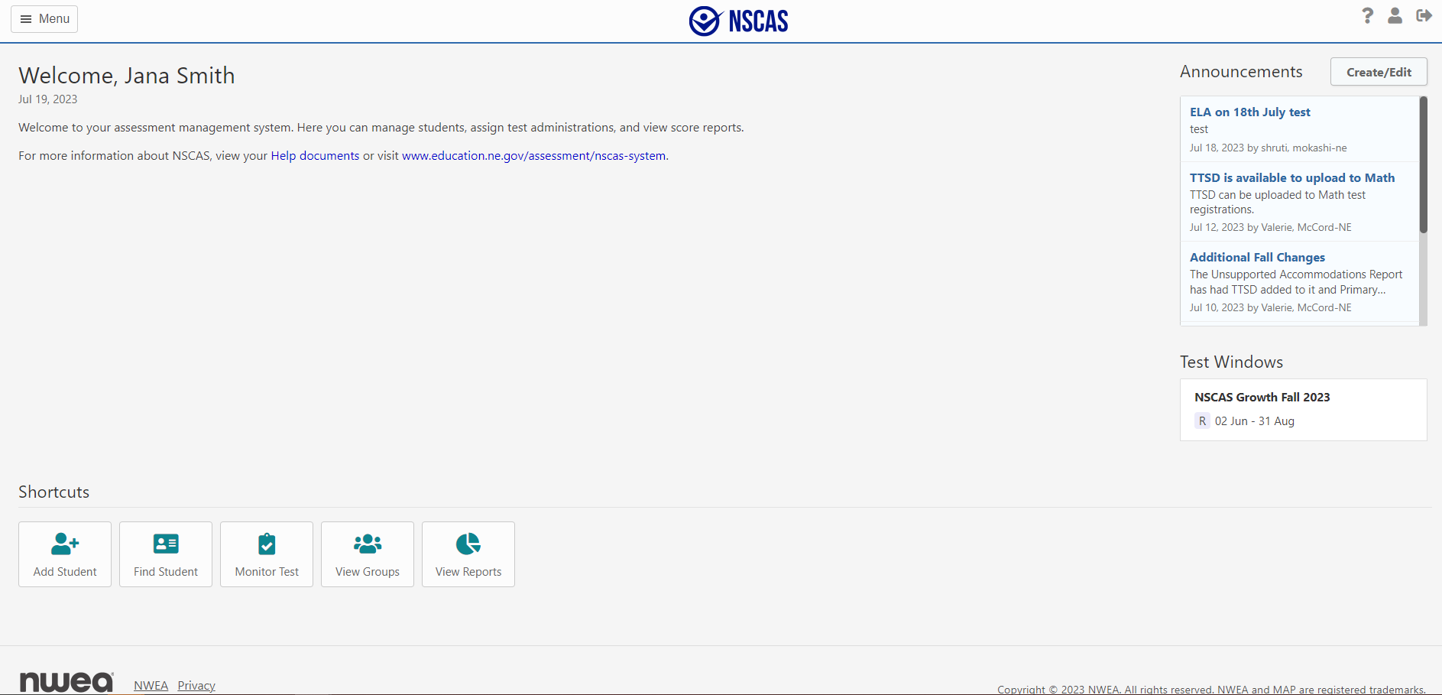

NSCAS Management
(Acacia)
Notes:
Here is the welcome screen in Acacia. Announcements and information for the test window is available on the welcome screen. There are shortcuts available for Adding a student, finding a student, monitoring a test, viewing groups, and viewing reports.

Slide 16
NSCAS Growth Tasks
MAP Growth Tasks (Districts Only) | Acacia Tasks
Import Student Rosters to MAP Growth | Update/add additional student information like accommodations and NTCs via upload of the Registration Report
Ensure instructors have rostered classes in MAP Growth | Print Test Tickets
 | Monitor Student Progress
 | Access Reports
 | Data Clean Up
Notes:
Here is an overview of required tasks for the NSCAS Growth Assessments. First, student rosters need to be imported into Map Growth and will sync over to Acacia nightly. Any accommodations, not tested codes, or any other test specific attributes need to be added within Acacia. Optionally, classes created in Map Growth will sync to Acacia as student groups for testing and reporting. Test tickets also must be printed and securely distributed to students prior to testing. Student progress during the assessment is monitored by the Proctor. Reports will be available 24-72 hours after testing. Finally, we also ask that data such as student demographics, NTC's and accommodations be entered and maintained throughout the window for data quality.

Slide 17
NSCAS Assessment Management
Rostering
Notes:
Next, we will cover Rostering.

Slide 18
NSCAS Growth – Rostering
Districts will upload their student rosters to the current MAP Growth term. The Term will be Spring 2024-2025.
  Districts need to upload a roster for each administration even if the records in Acacia are automatically rostered for each term.
Districts using Auto-rostering solutions such as Clever can be used, however only data from the current term will be synced.
  Note: If using Clever, please confirm your Term Start Date to ensure student data is synced prior to the Test Window date.
Student information will be synced to the NSCAS Growth State Platform nightly from MAP Growth starting on 03/03/25.
Notes:
Districts will continue to roster students into the appropriate term in map growth using their existing rostering processes, whether that's manual or using automated rostering such as clever. Keep in mind for clever only, data from the current term will be synced. A roster will be uploaded for each administration even if the records in Acacia are automatically rostered for each term. Please confirm your map growth test start date to ensure student data is synced. Prior to the test window date, student updates must be made prior to the sync to get accurate information into map. Student information will be synced to NSCAS Growth nightly starting on March 3rd, 2025.

Slide 19
NSCAS Growth – Rostering
Districts roster their students to MAP Growth
Data syncs between MAP Growth and NSCAS Growth nightly
Student Registrations are automatically created
Updated Student information will display in NSCAS Growth
The source of truth for student data is district data uploaded to the MAP Growth system.
Initial sync will:
  Create student profiles for the NSCAS Growth Administration.
  Create Test registrations in NSCAS Growth for required tests.
Data will continue to sync from MAP Growth nightly starting 03/03/25.
No ADVISER data is synced or uploaded to Acacia, except for 504, IEP, EL status and race. This data is only uploaded to records rostered for the current term in Acacia.
Notes:
The source of truth for student demographic data is map growth. The process follows these steps. Districts roster students to map Growth, Data syncs from map growth over to NSCAS Growth or Acacia nightly, student registrations are automatically created and the appropriate tests are assigned ,and then this updated information will show in Acacia for NSCAS growth that initial sync is going to create. The test registrations and the data will continue to sync nightly starting on March 3rd. No ADVISER data is synced or uploaded to Acacia, except for 504, IEP, EL status and race. This data is only uploaded to records rostered for the current term in Acacia.

Slide 20
NSCAS Growth – Rostering
It is the district’s responsibility to ensure student data is up to date in their SIS and ADVISER systems and imported to MAP Growth.
Districts can generate the Registrations Report within Acacia’s Operational Reports to make updates to accommodations, NTCs and Testing School to update in bulk.
  Overnight processing is required for these changes.
  The import can support 10,000 student records at once, for larger imports, please upload separate files.
Note: Student Profile information cannot be updated via the Registration File upload as this data is coming from MAP Growth. Please make any changes to student profiles/demographics in MAP Growth and wait for the nightly sync.
Notes:
It's the district's responsibility to ensure student data is up to date in their student information system and advisor systems and then imported into Map Growth. Districts can use the registration report within Acacia's Operational Reports to make any edits to test attributes such as accommodations, not tested codes, and testing school in bulk and then can reimport that file into Acacia. Overnight processing is required for these changes and the import can only handle 10 thousand student records at a time. You can choose to only import changes or upload multiple files if you do have more students that you need to make changes to. Please note that any student profile information comes over from map growth, so those cannot be changed directly in Acacia. You need to make any changes to student demographics directly within map growth and then wait for that overnight sync in Map Growth over to Acacia.

Slide 21
NSCAS Growth – Student Groups
Student Groups for Testing and Reporting will be synced from MAP Growth nightly with the other student data.
As MAP Growth is the source of truth, there will not be an ability to update Student Groups in the NSCAS Growth platform. These should instead be updated through MAP Growth and synced.
If a student moves out of the district, the district will need to unenroll the student in MAP Growth.
  If the student moves out of state or another district has not enrolled the student, the unenrolled student may still appear on the NSCAS Growth roster and an NTC code will need to be added to their registered test(s).
Notes:
Student groups for testing and reporting will be synced from MAP Growth nightly with the other student data. As this data comes over from map growth, any changes to these classes must also be done within the map growth roster or the Map growth platform. If a student moves out of a district, that district will need to unenroll the student in Map Growth and un-roster them from the current term. That district may then need to apply an appropriate, not tested code to any students who have left. If they see, they still appear in Acacia for NSCAS growth.

Slide 22
NSCAS Assessment Management
Accessibility
Notes:
Next, we will cover Accessibility options for the NSCAS Growth Assessments

Slide 23
Accommodations
Students with disabilities must be included in NSCAS Growth and NSCAS General in the following ways:
Students may be tested on the NSCAS Growth and NSCAS General assessments with and/or without accommodations.
Students may be tested on the NSCAS Growth and NSCAS General assessments with approved accommodations specified in the student’s IEP, 504 plan or EL plan. Accommodations provided to students must be specified in the student’s IEP or 504 plan and used during instruction throughout the year.
Districts should still ensure the student’s IEP, 504 Plan and/or EL Status is indicated on their profile in Adviser.
Notes:
Students with disabilities must be included in the NSCAS Growth and NSCAS General assessments in the following ways. Students may be tested on these assessments with or without accommodations. Any accommodations provided to students must be specified in the student's IEP, 504 plan or English Learner plan and used during instruction throughout the year. Districts should still ensure the students IEP, 504 plan and/or English Learner status is indicated on their profile in advisor. Students with significant cognitive disabilities that qualify for the NSCAS Alternate should only take the NSCAS Alternate.

Slide 24
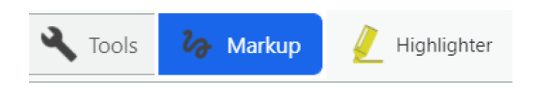
Accessibility
Universal Tools/Features
Scratch paper (lined or blank scratch paper or blank graph paper)
Math Reference Sheets: This will be available in the toolbar. May be printed from the Assessment Portal or the NDE assessment website prior to students testing online. Districts determine which math reference sheet is appropriate for use such as the Universal or grade level math reference sheet
Embedded resources
    Highlighter
    Notepad
    Zoom
    Line Reader
    Answer Eliminator
    Ruler/protractor
  Graph paper
  Color (color contrast)
  Universal Math reference sheets
Notes:
Next we will cover Universal tools and features that are available to all students. Universal tools that can be provided include scratch paper and math reference sheets, which are both available in the online assessment or can be printed and distributed to students from the assessment portal. Districts determine which math reference sheet they would prefer to use such as the universal or grade level math reference sheet. Embedded Universal tools and features include a highlighter, notepad, Zoom, line reader, answer eliminator, a ruler and protractor with applicable questions, graph paper, color contrast options and once again, those math reference sheets for linguistic supports.

Slide 25
Accessibility
Linguistic Supports
  Text to Speech in English and Spanish (available for all of Math and Science; ELA – not available for passages).
  Spanish Translations (online and paper).
  Additional non-embedded supports: See the Accessibility Manual
Accommodations
  Text to Speech in English and Spanish (available for all of Math; ELA – not available for passages).
  Spanish Translations (online and paper).
  Embedded calculator.
  Additional non-embedded supports: See the Accessibility Manual
Notes:
Linguistic supports include text to speech in English and Spanish for all of Math and Science. Spanish translations for both online and the paper assessment. Accommodations include test to speech in English and Spanish, Spanish Translations and an embedded calculator for all math items. The link to the accessibility manual includes all of the embedded and non-embedded linguistic supports and accommodations available.

Slide 26
Text to Speech (TTS)
TTS is available in both English and Spanish.
TTS for Math is now also available as a designated feature.
  Students that benefit from having generated audio but do not have an IEP or 504 Plan, and are not EL Learners may be eligible to use TTS as a designated feature.
  These students should regularly have access to generated audio during instruction. No student should have access to TTS if they do not use it regularly as part of instruction.
  Need for this accommodation will be indicated on the student’s test registration profile.
Districts should still ensure the student’s IEP, 504 Plan and/or EL Status is indicated on their profile in ADVISER systems.
Notes:
Text to speech is available in both English and Spanish. Text to speech for Math is now available as a designated feature, which means students that benefit from having text to speech but do not have an IEP, 504 plan and are not English Learners, can access and may be eligible to use text to speech as a designated feature. These students should regularly have access to text to speech during instruction. No student should have access to text to speech if they do not use it regularly as part of their instruction. This accommodation will be indicated on the student's test registration profile. Districts should still ensure the student's IEP, 504 plan and or English learner status is indicated on their profile in Adviser systems.

Slide 27
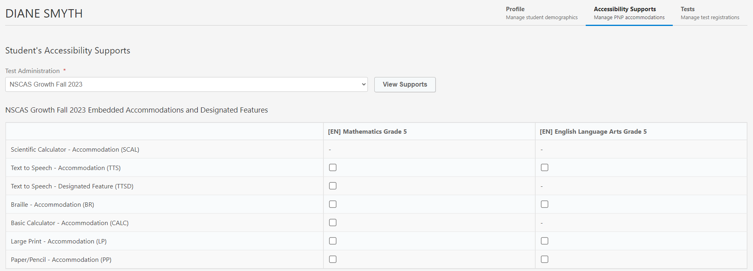
Text to Speech (TTS)
Assigning Text To Speech accommodation manually –Under Student’s profile, select Accessibility Supports and the subject for TTS, then Save changes at the bottom.
Notes:
When selecting text to speech manually, go to the student's profile, select accessibility supports, the subject for text to speech and then save the changes at the bottom.

Slide 28
Calculator as an Accommodation
An embedded calculator should be selected for students with IEPs or 504 plans in the NSCAS Growth Platform for Math.
  Guidance is in the Accessibility Manual.
  Need for this accommodation will be indicated on the student's test registration profile.
A calculator is available throughout the test.
  Grades 3–6: Basic
  Grades 7–8: Scientific
The calculator will display in the toolbar when enabled.
Notes:
An embedded calculator should only be selected for students with IEPs or 504 plans. Guidance for the use of a calculator on the math assessment is located in the Accessibility Manual. If a student has a calculator for an accommodation, they will have the use of the calculator throughout the test. A basic calculator is used for grades 3-6 and a scientific calculator is used for grades 7-8. The calculator accommodation will appear on the toolbar when it is enabled.

Slide 29

Accessibility - Paper
Paper accommodations will be available for students with a documented need, such as an IEP, 504 plan, or English Learner Plan.
  Need must be indicated on the student profile in Acacia.
    English and Spanish + Large Print – NWEA will provide a secure SFTP link to where the test materials will be posted for districts to download and print.
    Braille – NWEA will ship to DAC.
Transcription of Paper/Pencil Assessments
  No answer sheets to track! Students will indicate their response by circling their answer.
  After paper/pencil tests are complete, the scribe must transcribe the student's responses into the online test delivery system exactly as student has responded. Answers cannot be left blank. If a student leaves an answer blank, they should be prompted to answer the question. If a student refuses to go back and finish the questions, an NTC of Refusal must be used.
  This will ensure that students' responses are scored and remove shipping and processing time!
  Test materials should be securely destroyed locally, once the test has been scored.
Notes:
Students can receive a paper test as an accommodation with a documented need through an IEP, 504 Plan, or an English Learner Plan. The need must be indicated on the student profile in Acacia. A secure SFTP link will be provided to the District Assessment Contact where the test materials for English, Spanish, and/or Large Print can be downloaded and printed. Directions for enlarging a large print test are located in the Assessment Coordinator's Guide. Braille assessments will be shipped to the District Assessment Contact. When the student has completed their assessment, a scribe must transcribe the student's responses into the online test delivery system exactly as the student has responded. All answers must be completed. A student cannot leave an answer blank. They must be prompted to answer all of the questions. If the student refuses to complete the test, an NTC of refusal must be used. This ensures that the student's responses are scored and it removes shipping and processing time. Local districts will destroy test materials in a secure manner after the test has been submitted. Nothing is required to be returned.

Slide 30
Accessibility - Paper
Paper can be assigned like other Accommodations in the Student’s Profile
Notes:
Paper can be assigned like other accommodations in the student's profile.

Slide 31
Accessibility in the
NSCAS Platform
Non-embedded Universal Tools
Alternate location
Directions
Flexible scheduling
Noise buffer/Headphones
Redirection
Scratch paper
Read aloud-Student reads test aloud.
Non-embedded Linguistic Supports
Bilingual dictionary
Native language translation
Embedded Linguistic Supports/ Accommodations
Text to Speech English (Accommodation)
Text to Speech Spanish (Accommodation)
Text to Speech English (Designated Feature)
Text to Speech Spanish (Designated Feature)
Calculator
Non-embedded Accommodations
Assistive Technology
Mathematical Support
Specialized presentation of test
Scribe
Setting
Notes:
The following Accessibility supports are available as universal tools or accommodations for students in the NSCAS platform.

Slide 32
Testing School
Off-site Testing
  Testing School = school of attendance or enrolled.
  Testing School can be updated/changed by the Registration Report or manually through the student's Profile in Acacia, but not through CAP rostering
  Students testing at different buildings can be easily assigned a Testing School during Registration
    Ex. External Programs
  Proctors at these alternate testing schools can access test tickets to test students.
Notes:
The testing school is the school of attendance or enrolled. The testing school can be updated or changed by the registration report or manually through the student's profile in acacia but not through CAP rostering. Students testing at different buildings can be assigned a testing school during registration. Proctors at these alternate testing schools can access test tickets to test students.

Slide 33
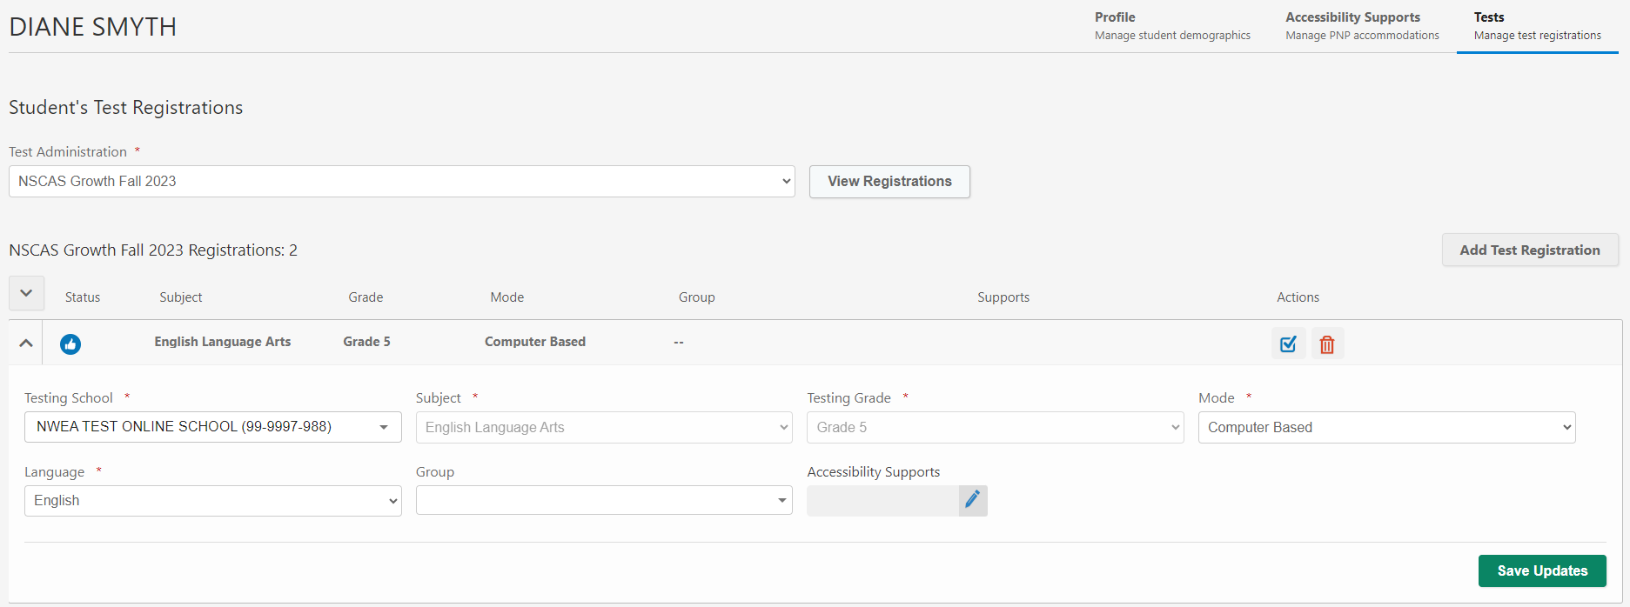
Testing School
Notes:
The testing School highlighted in red is the school providing the testing for the student.

Slide 34
NSCAS Assessment Management
Not Tested Codes
Notes:
Next up we have Not Tested Codes for NSCAS Assessment Management.

Slide 35
Not Tested Codes
Code | Description | Explanation of Use
ALT | NSCAS Alternate Assessment | Student participated in the alternate assessment.
EMW | Emergency Medical Waiver | Student was not tested due to a medical emergency. Requires NDE approval.
EXP | Exception | Student exempt from testing due to circumstances, such as student requiring an unavailable accommodation; student is attending an out-of-state facility; or testing irregularities. Requires NDE approval.
FTE | Not Full Time | Full-Time Equivalency is less than 51% so the student is excluded from testing. NDE will verify.
INV | Invalid | Student's assessment was invalidated; such as security breach or testing irregularity. Requires NDE approval.
LBW | Left Before Window | Student withdrew from district/school BEFORE the test window(s) began.
NCE | Not Currently Enrolled | Student entered or withdrew from the district/school during the testing window.
Notes:
Here is an explanation of the Not Tested Codes on the next two screens.

Slide 36
Not Tested Codes
Code | Description | Explanation of Use
OTH | Other | Student was not tested for reasons not covered by other descriptions. For example, occurrence of a natural disaster. Requires NDE approval.
PAR | Parental Refusal | Student was not tested because of a written request from parent or guardian.
STR | Student Refusal | Student was not tested due to student refusal to participate.
UTT | District Unable to Test Student | District was unable to test the student during the testing window due to excessive absences or suspension/expulsion.
NTCs are updated through Actions on the Test Management page in the student's profile under Accessibility Supports or an updated Registration Report upload
Notes:
Not tested codes can be added in the student's profile under Accessibility supports or an updated Registration Report upload.

Slide 37
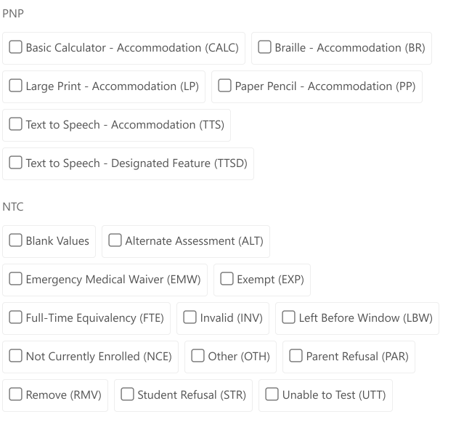
Adding
Accommodations + NTCs
Notes:
Accommodations and NTCs are located in Manage Online Testing. The following not tested codes require approval from the Nebraska Department of Education before they should be selected; Exception, Invalid, Other, Emergency medical waiver, and Removal.

Slide 38
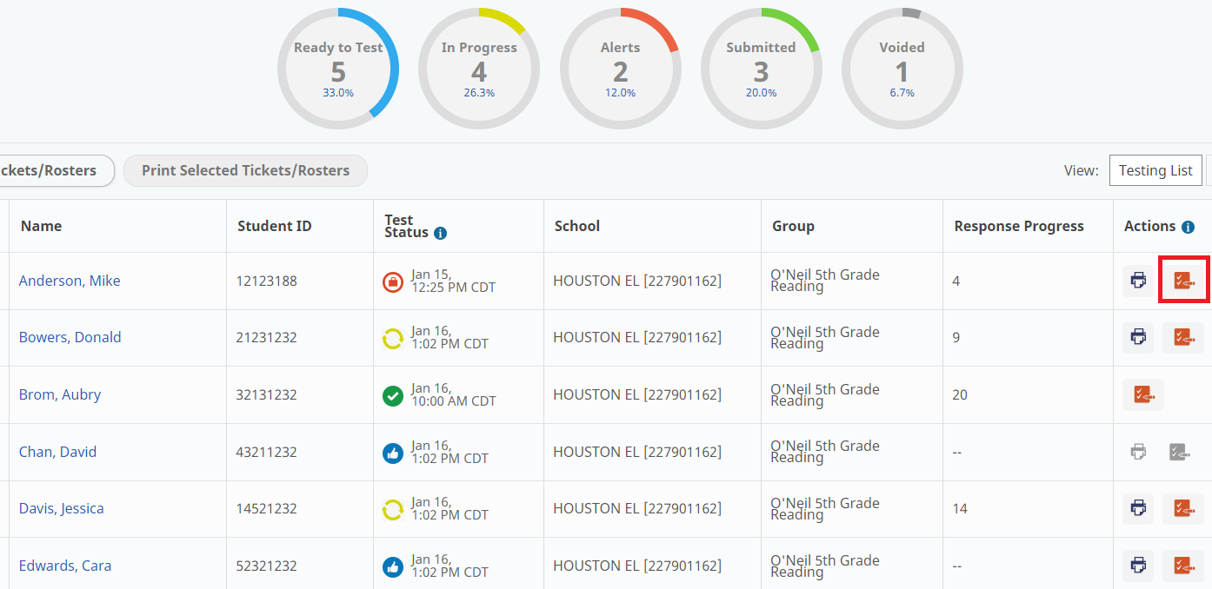
Adding
Accommodations + NTCs
Notes:
Not Tested Codes can be updated on the Manage online testing screen as shown here by clicking on the red icon on the right with the paper and pencil

Slide 39
NSCAS Assessment Management
Preparing for and Monitoring Testing
Notes:
Next up, we will cover how to prepare for and monitor the assessment.

Slide 40
Roles for Testing Students
 | District Assessment Coordinator | School Assessment Coordinator | Proctor
Assign Accommodations | X | X
Assign Not-Tested Codes | X | X
Create Optional Student Groups (In MAP Growth as Classes) | X | X
View Manage Online Testing Dashboard | X | X | X
Print Test Tickets | X | X | X
Proctor Registered Tests |  |  | X
Notes:
Here are the roles that are used for testing, along the top you see the roles and along the left are the permissions so both District and School Assessment Coordinators can assign accommodations, assign not tested codes, create student groups in MAP Growth, view and manage online testing and print test tickets. The Proctor is also able to view the Manage Online Testing dashboard, print tickets as needed and actively proctor registered tests.

Slide 41
Print Student Test Tickets
Available in two formats:
  PDF Format (one or four per page)
  CSV Export (For bulk printing)
In two ways:
  Manage Online Testing page
  Individual Student Profile, Test Registrations tab
Proctors can print on demand.
There is a roster in a pdf that shows the list of tickets that have been printed.
Students don't have to be in test groups to access a test ticket.
If the student has their ticket, they can log in and test!
Notes:
Test tickets can be generated and printed in multiple ways. They can be generated as PDFs, either one or four per page, or generated as a CSV if you'd prefer to format and print in your own formatting. Test tickets are accessed from the Manage Online Testing dashboard and can be accessed individually under a student's profile. If needed, proctors also have the ability to print on demand and will have access to a roster of students in their testing group. Students do not have to be in a group to have access to a ticket or to take the test. As long as the student has their test ticket available, they can log in and test without the Proctor needing to take any actions in the online system.

Slide 42
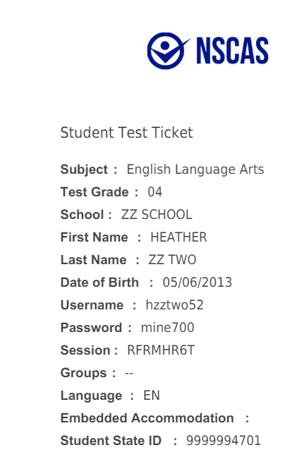
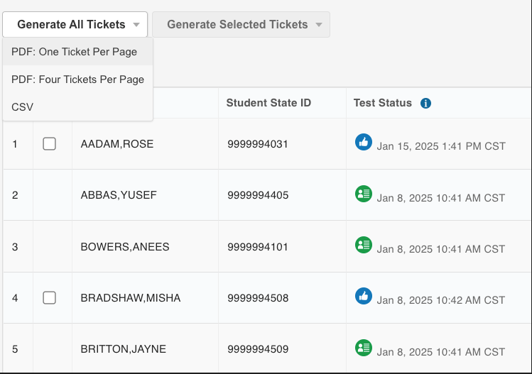
Student Test Tickets
Multiple student tickets can be printed at once or printed individually.
Test tickets print 1 or 4 to a page.
  Four Tickets Per Page can be selected in the system.
Notes:
From within Manage Online Testing, you can select the students you need to test and click the Print All Tickets button and you'll have the option to choose from one or four to a page. Here along the bottom right is a preview of how the student test tickets will look and please note the login credentials students will need to log in and take the assessment.

Slide 43
Retest Guidelines
Retest requests should be rare, instructionally relevant, made with due consideration, in the best interest of the student and consistent across districts.
Retest requests should NOT be used to raise scores for accountability or due to failures of staff to use reasonable discretion.
Below are some of the situations in which a student’s test may be reset or moved to another profile.
  Issues with test details (i.e., time taken, proctor observed rapid guessing, technology concerns)
  Non-quantitative concerns (i.e., classroom disruption, medical issues)
  Emergency evacuation.
  Student signed in under a different student's name
  Student did not receive the appropriate accommodations
  Note: Retest requests must come from the DAC through the NSCAS Growth Reset Form.
  Spring 2025 Reset Form: https://app.smartsheet.com/b/form/5c808b4f34a24d36a72645660bb1fd2b
Notes:
In certain circumstances, a student's test can be reset. Some of these circumstances include a student signing in under the wrong name, student began testing in the wrong language or with the wrong accommodations available, or situations such as an emergency. Please review the Nebraska Department of Education's guidance for when a test reset is applicable. Also, please note that reset requests must come from the district Assessment Coordinator through the NSCAS Growth reset form. NWEA will automatically log and grant the request, but the Nebraska Department of Education will regularly review these logs to ensure there is no misuse or abuse.

Slide 44
Operational Reports
Operational Reports: These reports are designed to help DAC and SAC monitor testing status and the status of materials.
To access operational reports:
  In the main menu, select Reports > Operational.
  Select the Organization and Report Type from the drop-down lists.
  Select Find.
  Information about the report appears below. Select the icon in the Download column to download the report.
Data file layout for each report is in the Help section to reference format.
Notes:
To help track testing progress throughout the window, operational reports are available to District Assessment Coordinator and School Assessment Coordinator users within Acacia. You can click reports along the left and then operational. You can then choose the needed report type from the drop down.

Slide 45
Operational Reports
MAP Growth Roster Errors Report
Operational Report | Description
Material Orders Report | This report lists each school that needs paper/pencil, braille, or large print forms, and how many of each kind of form were requested for each grade. It also includes the shipping contact and shipping address for each school.
Organization Report | Report details the Organizational Hierarchy data in the system. The source of this data is the state Organization file.
Registration Report | This report shows each organization to which you have access, including the name, type (such as school or district), code, shipping information, phone number, and the code for the organization’s parent organization
Student Mobility Report | This report lists each student transferred between organizations during the assessment window, including information such as the student’s previous district and school, current district and school, the date and time the student was transferred, the user who initiated the transfer, and the reason provided for the transfer.
Summary Testing Status Report | This report shows how many students are in each testing status (such as Ready to Test, In Progress, Inactive, or Submitted) at each school, grade, language, and content area combination.
Testing Status Report | This report contains the same data as the Registrations report, with additional columns listing the student's current testing status and the date and time the status was last updated
Student Results File | The Student Results File lists students and the tests they are registered for, and includes score data such as the scale score, RIT score, RIT achievement percentile, and any NTCs applied. It also contains information about reporting categories, such as reporting category scale score, RIT score, and the number if items attempted in each reporting category.
NTC Usage Report | This report shows each test registration to which an NTC was applied. It shows information about the student, the test registration, including content area, and any assigned accommodations, the district and school of attendance and accountability, the online testing group name, and the NTC assigned.
Notes:
NSCAS Growth and NSCAS General Science have multiple operational reports available for district usage. The Materials Order report will summarize which and how many paper tests and braille tests have been requested by the district. The organization report will show a list of which schools are part of your district. The registration report is going to give an export of all students that have been rostered to the system. This is a great one to download if you need to make any changes in bulk to things like accommodations or not tested codes and can be reuploaded into Acacia. The Student Mobility Report is going to show which students that have transferred in or out of your district or any schools within your district. The Summary Testing Status report will provide totals of which tests are in which status. So you can see how many students are complete, not started, et cetera. The testing status report will show the status of each student's test individually, so you get a little more student level detail. The NTC usage report shows each NTC that was applied for each test registration.

Slide 46
Student Mobility
District Transfers
As MAP Growth is the source of truth for student data, if a student transfers out of your district, they must be un-rostered from the current term so they do not continue coming through the sync.
In MAP Growth, you can locate the student’s profile and remove the current term and save changes.
Transfer the student to the new school within Acacia
To move a student and their testing data to a new district in MAP, submit the following form: MAP District Transfer Form.
If using Clever, choose to stop sharing this student as part of your data set.
Once the student is rostered in the new district, they will be available to test at the new location.
Notes:
There is a process that needs to take place for student mobility. MAP Growth is the source of truth for student data. If a student transfers out of your district, they must be un-rostered from the current term in MAP Growth so they do not continue coming through to Acacia through the sync. In MAP Growth, you can locate the student's profile and remove the current term and save changes. Next the District Assessment Contact will transfer the student to the new school in Acacia. We recommend keeping the student's historical testing data on the MAP Growth side by submitting the MAP District Transfer Form linked on the slide. If you are using clever, you will want to choose to stop sharing this student as part of your data set so they are no longer being synced into MAP Growth. Once the student is rostered in the new district, they will be available to test at the new location and their reports will be available there.

Slide 47
Test Security
Training is the responsibility of the building principal with assistance from the DAC.
Test administrators, test proctors, and test coordinators must be trained prior to test administration.
Training materials are provided by NDE and NWEA.
School districts may provide supplementary training materials.
Educators and principals will become familiar with specified testing practices and appropriate assessment accessibility supports for testing. See the Nebraska Student-Centered Assessment System Accessibility Manual.
The building principal’s signature on a signed security agreement affirms they will insure training for all staff.
Notes:
It is the responsibility of the building principal with assistance from the District Assessment Contact to provide training. Test administrators, test proctors, and test coordinators must be trained prior to the test administration. Training materials are provided by both NDE and NWEA. School districts may also provide supplementary training materials. Educators and principals will become familiar with specified testing practices and appropriate assessment accessibility supports for testing through the Accessibility Manual. The building principal's signature on a signed security agreement affirms they will insure all staff have been trained.

Slide 48
Proctor/Student
Experience
Notes:
Next up we're going to cover what the Proctor and student experience is like.

Slide 49
Proctor / Student Experience - Login
Step 1:
Student launches secure browser
Step 2:
From Test Ticket, student enters username, password, and session ID
Step 3: Student verifies text on screen is accurate while Proctor monitors
Step 4: Proctor gives verbal approval to start
Notes:
The first step is the student needs to launch the secure browser application on their device, as shown here with that blue NWEA icon. Next, the student will log in using the three credentials on their test ticket; the username, password and session ID, . Then student verifies the information they see is accurate, so it shows their correct name, grade, subject. The Proctor will walk around the room, monitoring and confirming everyone is logging in using the correct credentials. Once the Proctor has confirmed, the Proctor will give verbal approval to start and the students will continue and begin the assessment.

Slide 50
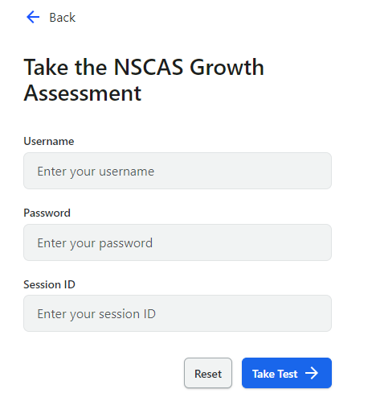
Student Experience:
Session Name & Password
Notes:
Here is a screenshot showing what it looks like on the student's side. When they login, they will see this screen with the three credentials.

Slide 51
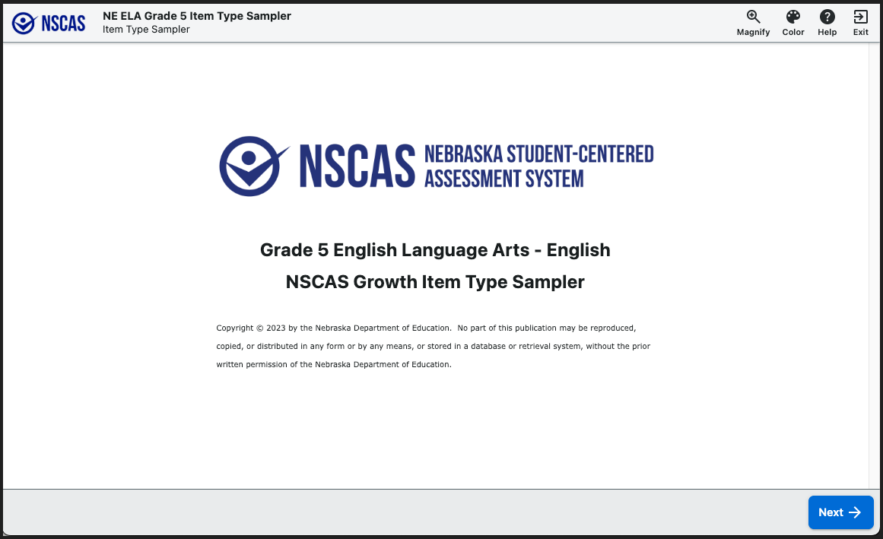
Student Experience
Notes:
Once the student is logged in, they will see this screen showing their grade and which subject they are taking.

Slide 52
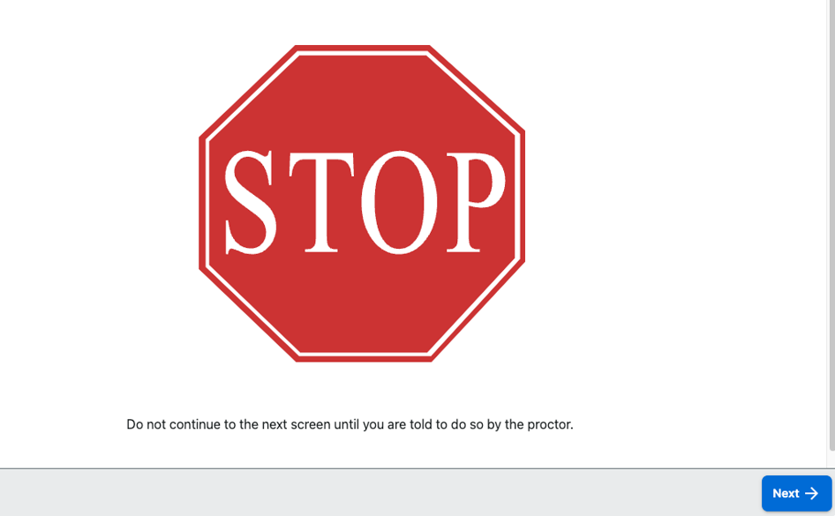
Student Experience
Notes:
The stop screen appears next to make sure that the student does not begin the test until they get confirmation from the Proctor to begin. This is the opportunity for the Proctor to make sure the students are all logging in with their test tickets.

Slide 53
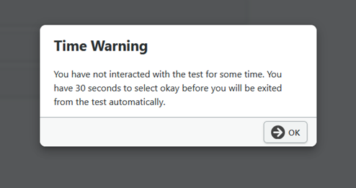
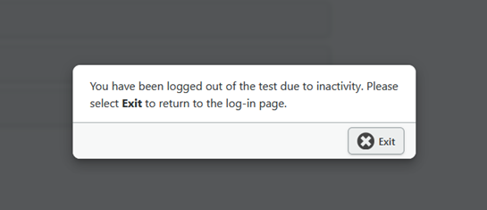
Student Experience
Logout
Inactivity
Message appears when student has been idle for 14.5 minutes.
If student doesn’t click within the screen then they will get the time out message.
  Once they receive this message then clicking exit is their only option.
Notes:
If a student's test is idle for 14.5 minutes, they will get a Time Warning message that they have not interacted with the test for a while and will have 30 seconds to select the okay button before they will be exited from the test automatically. Once they receive the message that they have been logged out, their only option is to select the exit button.

Slide 54
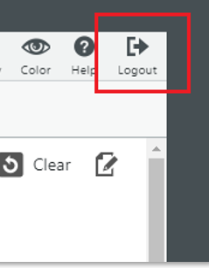
Student Experience
Logout
Students can pause their test by selecting the logout button. When they log back in with their test ticket, they will resume where they left off in the test.
Notes:
If for any reason, a student needs to pause their test, they will select the logout button in the upper right corner. When they log back in with their test ticket, the test will resume where they left off in the test. The test may look like the student is starting over when they pause and resume, but they are not starting over.

Slide 55
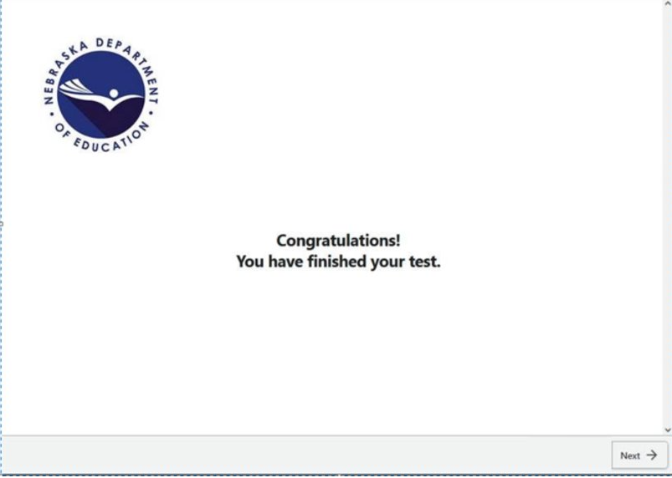
Student Experience – End of Test
Notes:
Once the student has finished their test, they will see the screen that the test is finished.

Slide 56
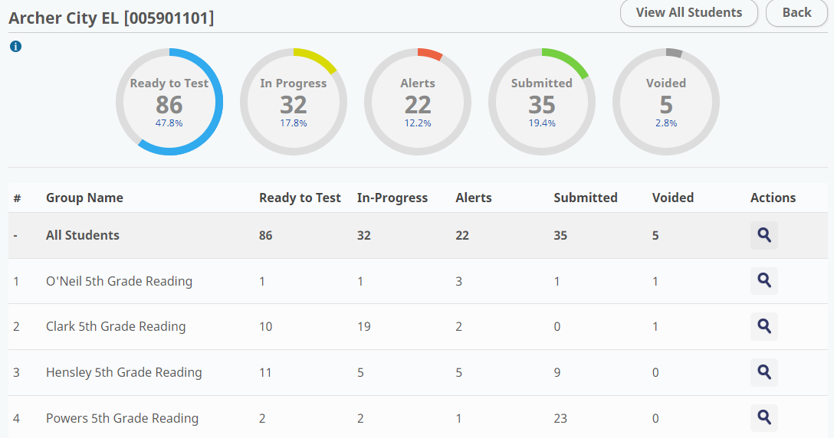
Testing Progress
Ease of use to allow proctors to more efficiently monitor students.
Testing Status Report can help understand where your students are in testing.
Note: Students with NTCs will show as Ready To Test.
Notes:
The Proctor can go into Manage Online Testing to see how many students are in each status. Students with not tested codes will show as ready to test.

Slide 57
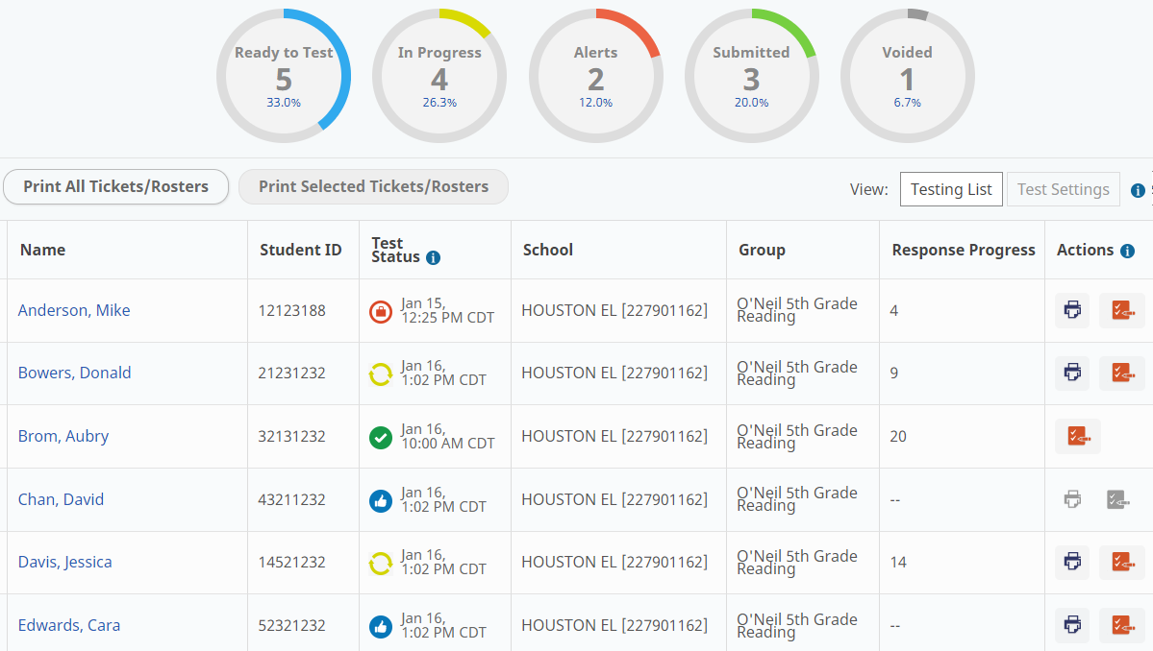
Testing Progress
Proctors will be able to monitor status from the test group, school or can look up students individually.
Notes:
Proctors will be able to monitor status from the test group, school, or can look up students individually.

Slide 58
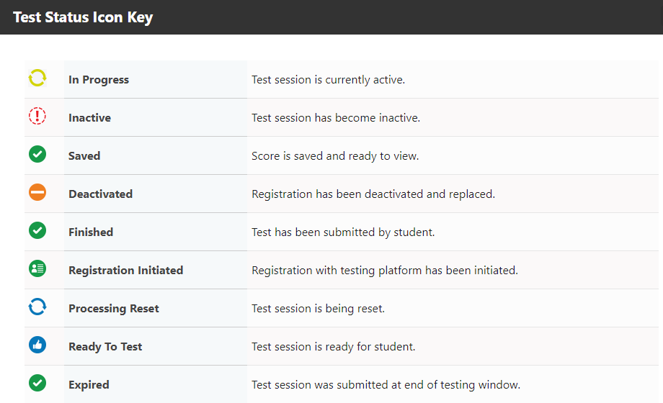
Testing Progress
Notes:
Here is the test status icon keys showing the different test statues to help the proctor understand where the student is in the process.

Slide 59
Reporting Issues
Problem item reports
  Should students experience an item that is potentially problematic, a problem item report can be submitted via the NWEA Assessment Portal.
  Click Nebraska Dedicated Support
  Log into NWEA Connection
  Select Contact Partner Support
  Enter the following information:
    Student State ID
    Grade and Subject
    Item Number (available on the student's test screen)
    Description of the issue
Note: Do not take photos or screenshots or provide details about the content of the item.
Notes:
If a student encounters a problem with an item, a problem item report can be submitted through the NWEA assessment Portal. First click the Nebraska dedicated support and then login to the NWEA connection and select contact partner support. Next you will enter the state student ID, Grade and Subject, the item number and a description of the issue. For example, if the problem item was the fifth item in the test, then we can go in and take a look and verify if there are issues with the item. It is very important to note that no photos or screenshots should be taken or provide the content details of the item.

Slide 60
Test Management
How-to Videos that are available:
  How to Assigns Accommodations
  How to Assign NTC's
  How to Print Test Tickets
Location:
NWEA Nebraska Assessment Portal - Assessment Coordinator Tab
Notes:
There are how-to videos that demonstrate how to assign accommodations, how to assign not tested codes and how to print test tickets. These are available on the Nebraska Portal and on the link at the bottom of this screen.

Slide 61
NSCAS – Student Tutorials
Interactive video available for students to learn how to use the online test platform.
  How to use the online tools
  How to navigate through the test
  How to respond to different item types
  Test-Taking Tips
Link to NSCAS Growth Student Tutorial
Notes:
Three are several resources available to assist student with preparing for the assessment. There is an NSCAS Growth Student tutorial that is available to students to learn how to use the online platform. This video shows how to use the online tools, how to navigate through the test, how to respond to different item types and some general test taking tips.

Slide 62
Item Type Samplers
  Purpose: Provide students with an opportunity to practice each item type and gain familiarity with the platform/interface.
  Includes all item types and item aides for each grade level.
  Accessed on the Assessment Portal.
  Paper item type samplers are also provided as PDFs for Districts to download and print (including answer documents).
  Braille item type samplers can be requested with the Braille order.
Resource: Item Type Samplers
Location: https://nscas-assess.state.nwea.org/inbrowser/index.html
Notes:
Next, we have the Item Type Samplers. These provide students with an opportunity to practice each item type and gain familiarity with the platform. It includes all items types and item aides for each grade level. The online and paper item type samplers also provide answer keys to check student answers. We also have the paper item type samplers on the Nebraska portal that can be downloaded and printed out for students that will use the paper test. Braille item type samplers are also available with the braille test and must be ordered.

Slide 63
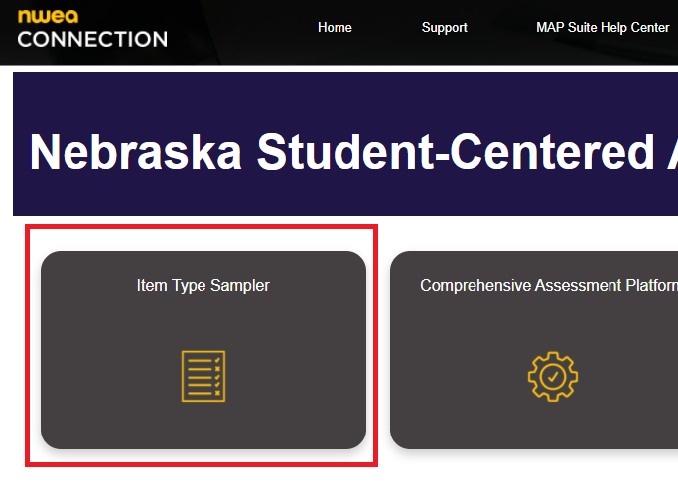
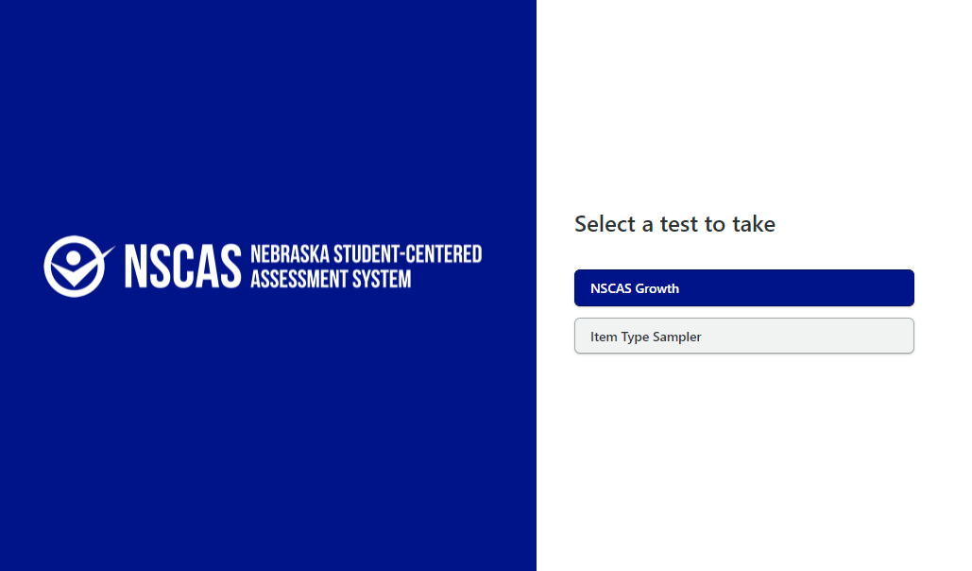
NSCAS – Item Type Samplers
Notes:
This screen shows where you need to select to get the item type samplers on the Nebraska Portal.

Slide 64
Data and Reporting
Notes:
Next up We'll cover data and reporting.

Slide 65
Data and Reporting: What is available
Report/File | Access | Description
Student Score Report - By District | District Coordinators and Admins | Available on a rolling basis Demographic filters Averages for the district
Student Score Report - By School | School coordinators, Admins and above | Available on a rolling basis Average for the school Graphic views of student performance
Student Score Report - By Group | Instructors and above | Available on a rolling basis Similar to class level view of MAP Growth reports Will have averages for the group Graphic views of student performance Users will be able to create groups to get
Online Student Report | Instructors and above | Available on a rolling basis Student performance data in an easily printable format focused on each content area separately Item level information by standard, item type, and difficulty
Notes:
All of these reports are available on a rolling basis. The Student Score Report by district can be filtered and sorted by groups to show averages for the district. The Student Score Report by school provides averages for the school and graphic views of student performance. The Student Score Report by Group shows averages for the group. Then we have the online individual student report that shows student performance data in an easily printable format focused on each content separately. It provides item level information by standard, item type, and difficulty.

Slide 66
Data and Reporting: MAP Growth Reports
RIT score data from NSCAS Growth is also available in MAP Growth and the various MAP Growth reports.
Popular reports such as Student Profile, Class Profile and Family Report (and more) are all available
  Note: Learning Continuum and Learning Statements are not available for NSCAS assessments.
If a student has taken both MAP Growth and NSCAS Growth in a term, the test with the lowest Standard Error of Measure (SEM) will be the one reportable in MAP Growth.
Only NSCAS Growth assessments will appear in Acacia reporting, not MAP Growth assessments.
Note: The Student Progress Report, Student Growth Summary Report and District Summary Report in MAP Growth will remain active through Summer 2025.
Note: Rapid Guessing metrics are not available for NSCAS Assessments
Notes:
RIT score data from NSCAS Growth is made available in MAP Growth and all of the various MAP Growth reports. Reports such as the student profile, class profile and family report are available. One note is that the learning continuum and learning statements are not available in NSCAS assessments. If a student takes both MAP Growth and NSCAS Growth in a term, the test with the lowest standard error of measure will be the one reportable in MAP Growth. Only NSCAS Growth assessments will appear in Acacia reporting and not MAP Growth assessments. The following information is for MAP only. The student progress report, student growth summary report, and the district summary report will remain active in MAP Growth through the summer of 2025. Also, Rapid Guessing metrics are not available for NSCAS Growth Assessments.

Slide 67
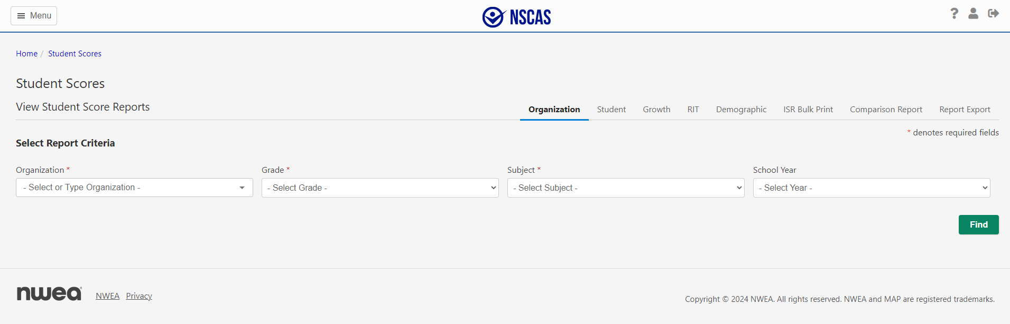
Reports
Notes:
To go in and download reports on the Acacia side you would click on reports. Along the left and then student score reports. From here you'll have different categories on the right to choose from and then different dropdowns to select the organization level, your school or district as well as grade, subject and then the school year and click on find.

Slide 68
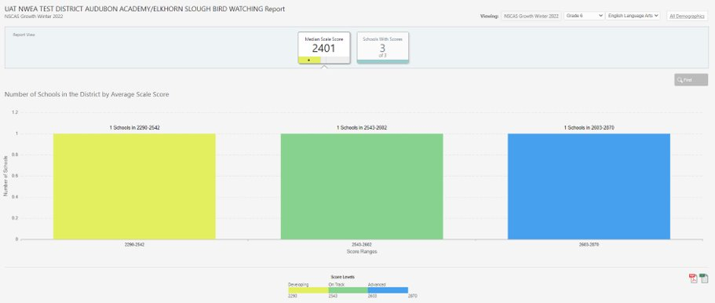
Reports:
District Level
Notes:
In this case, we've gone in and chosen a district, so you'll see the median scale score along the top and then you'll also see how many schools within that district fell into one of the three reporting categories. When you click on one of those bars in the bar graph, then you'll be able to go to the school level.

Slide 69

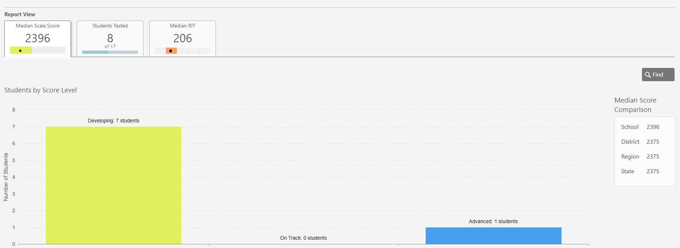

Reports:
School Level
Notes:
Now that we are at the school level, you can see how many student within that school fell into a specific achievement level. You can see the Median scale score for that school and the grade and subject chosen.

Slide 70
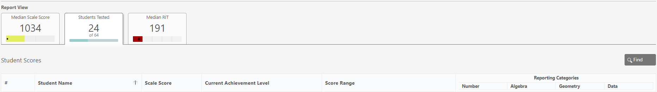
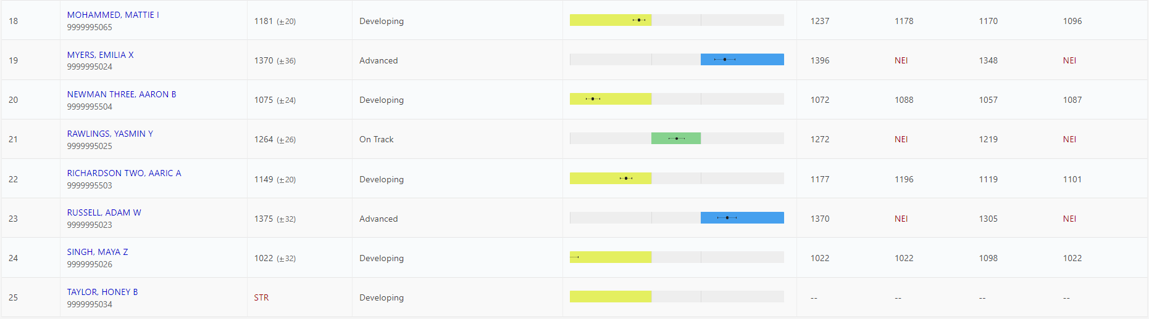
Reports:
School/Group Level
Notes:
If you want to see a group, click on the Students Tested tab to see students listed individually.

Slide 71
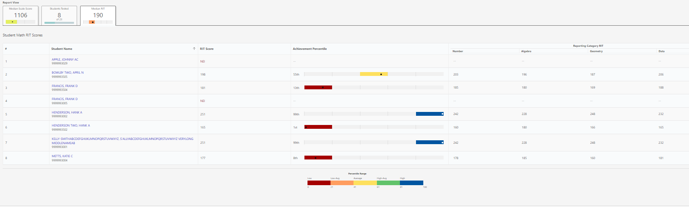
Reports:
School/Group Level
Notes:
If you click on the Median RIT tab, you can see students' overall RIT score and percentile ranking as well as the Reporting Category RIT scores along the right.

Slide 72
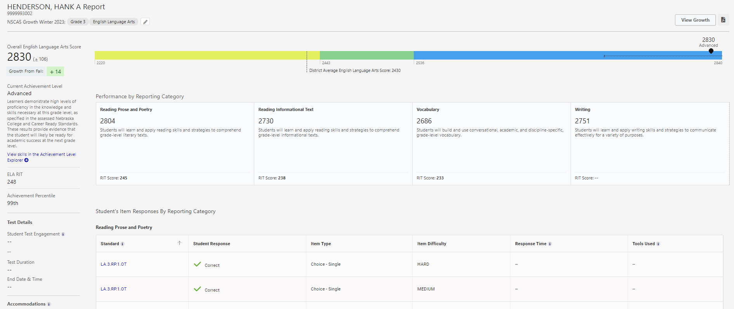
Reports:
Student Level
Notes:
When you select an individual student from the school or group level, you are able to see where the student fell along the achievement level range. You can see scores within the different instructional areas or reporting categories within the subject. You can also see how students responded to different standards listed below.

Slide 73
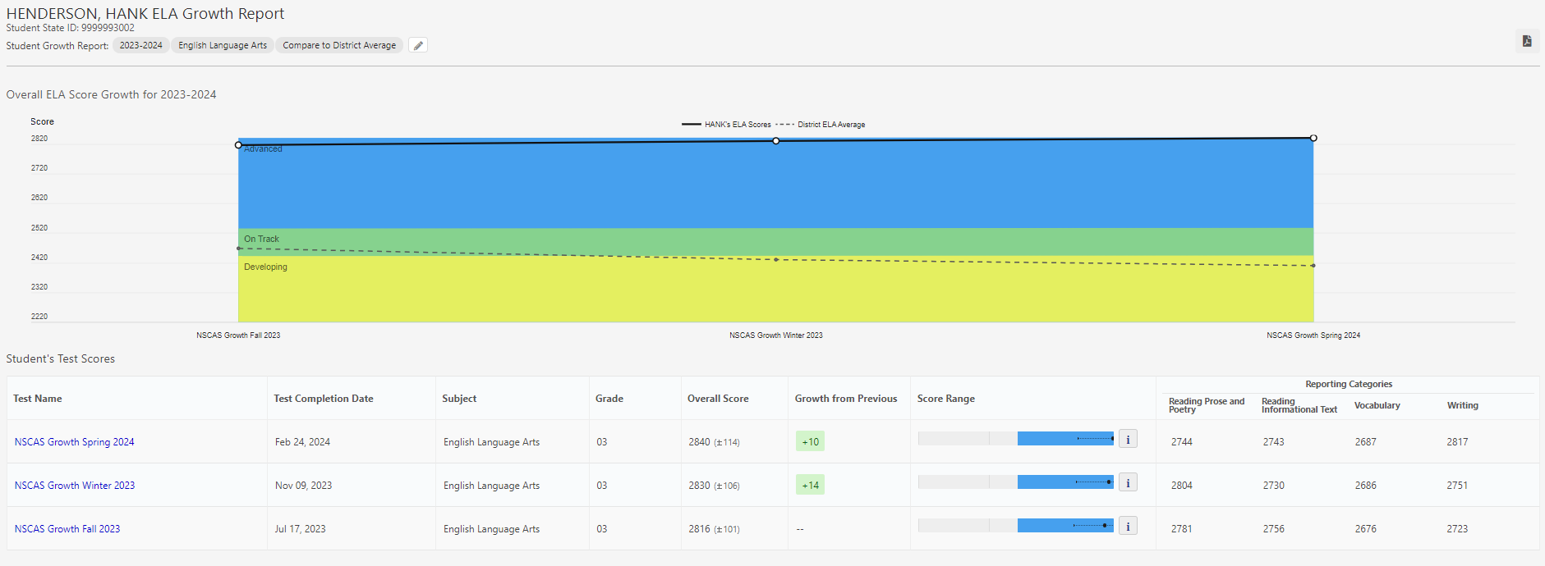
Reports:
Growth Report
Notes:
If a student tested in multiple admins, the Growth Report will show an individual student's growth over the entire academic year. Details for each test, including the student's overall score, growth from the previous test (if available), score range, and reporting category scores, are shown in a table below the graph.

Slide 74
Reports
Notes:
Starting in Spring 2024, users will have two new options for viewing score data: The Comparison Report Builder and the Report Export.

Slide 75
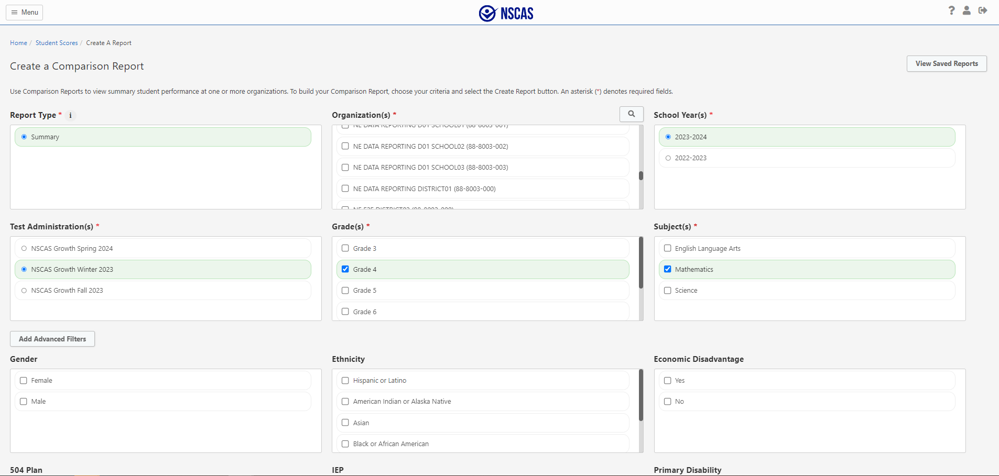
Summary Report
Notes:
The Comparison Report Builder allows you to build reports using multi-select fields based on the organizations, grades, subject, and demographics you select. Report queries can be saved for reuse in the future.

Slide 76
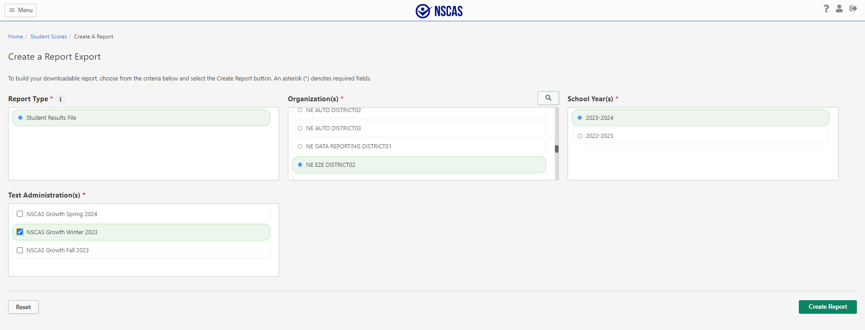
Report Export
Notes:
Starting with Spring 2024, the district-level Student Result File will be accessed via the Report Export tab. The Student Results File is a CSV download of test-level data.

Slide 77
External Programs
Notes:
Next, we will talk about providing assessments for external programs.

Slide 78
Resident Districts
EXTERNAL PROGRAMS
Accountable District Actions
  Resident Districts must Register all students they are accountable to test, including those attending and testing at external programs.
Option 1:
  Testing School (external program) can be identified by changing the Testing School for each test via the Registration Report import or manually in Acacia. This must be performed by the Resident District. Test Tickets available to print at external program.
Option 2:
  Test tickets are sent via a secure manner (Secure email, secure SFTP, or hand delivered) to the external program for student to test.
Responsible for rostering and communicating with the external program coordinators
Notes:
This first slide is for the resident districts where the student is responsible or accountable to. These programs are responsible for rostering and then communicating with the external program coordinators where the student attends. The resident districts must register all students who are accountable to test including those attending and testing at external programs. we do have two options for how to get the test ticket over to the external programs. The testing school can be identified by changing the testing school for each test via the registration report import or manually in Acacia. This must be performed by the resident district. Test tickets are available to print at the external programs. The second option is to send test tickets via a secure manner such as a secure email, secure SFTP or hand delivered to the external program for the student to test.

Slide 79
External Program - School Assessment Coordinators
EXTERNAL PROGRAMS
Assessment Management
  Primary Duties:
  Develop a scheduling plan for the testing window including proctors.
  If Option 1 is used, Verify student rostering – Attending Location.
  Print test tickets if Option 1 is used.
  Update accommodations if needed, after verifying with the resident district.
  Secure handling of test materials.
  Coordination of test proctors.
  Monitor Student Testing Progress.
  Create make-up test sessions.
Serve as single points of contact for resident districts and are responsible for coordinating the testing activities including training staff within their external programs.
Notes:
External programs serve as a single point of contact for resident districts and they're responsible for coordinating the testing activities and staff training within their external programs. Their primary duties are to develop a scheduling plan for the testing window, including proctoring. Verify that student rostering is complete and that they're listed as that attending location. Then they have access to print those test tickets locally. They need to verify with the resident district to ensure all needed accommodations have been applied and are updated so they're available for the student. External Programs will need to make sure they securely handle any test materials, such as paper materials. They'll also help coordinate proctors, monitor student testing progress and create any makeup test sessions as needed.

Slide 80
Proctor Role
EXTERNAL PROGRAMS
Proctor Responsibilities
  Prepare the testing environment including providing scratch paper.
  Ensure approved accommodations are provided during testing.
  Distribute Student Test Tickets.
  Monitor the test session to ensure a secure and productive test setting.
  Adhere to all security requirements.
  Securely return all test materials when testing is complete.
Start and manage testing as outlined in the Test Administration Manual
Notes:
Proctors at External programs will start and manage testing as outlined in that test administration manual. They'll make sure that the testing environment is prepared and students have any materials they need, such as scratch paper. External programs will make sure approved accommodations are provided during testing, distribute the student test tickets, monitor the session to ensure secure and productive test setting, adhere to all security requirements and then return all test materials when testing is complete. In the case of any paper materials, as we mentioned before, those need to just be securely destroyed locally, and those do not need to be returned, but anything else that may be coordinated between the program and the resident district needs to be handled securely, such as those test tickets.

Slide 81
Preparing for Testing
Notes:
Now on to a few final steps to prepare for testing before administering any NSCAS assessments.

Slide 82
Preparing for
NSCAS Assessments
Review technical requirements for NSCAS Testing.
Download new NWEA State Solution Secure Browser.
Uninstall previous version before install.
Review NDE guidelines for accessibility and identify individual students in need of specific accommodations.
Review scheduling guidance from NDE.
Review NDE Test Security Manual.
Notes:
The technical requirements for NSCAS testing must be review prior to testing. The NWEA state solution secure browser will need to be installed with the newest version. The Nebraska Department of Education's guidelines for accessibility and accommodations must be reviewed and followed. The scheduling guidance is a great tool to review prior to administering the NSACS assessments to be prepared to allocate the time needed when scheduling testing. One last document that must be reviewed in the Nebraska Department of Education's Security manual to ensure proper measures have been followed to provide secure testing.

Slide 83
Suggestions for a
Smooth Testing Experience
Enable audio on devices used for TTS & provide headphones.
Ensure all students have appropriate accessibility feature assigned, as needed.
Validate school proctor rights have been assigned.
Use the Manage Online Testing Dashboard to monitor testing progress throughout the test window.
Refresh Manage Online Testing Dashboard to see updated information.
Notes:
Here are a few more suggestions to keep the testing experience going smoothing. Make sure that audio is enabled on devices used for text to speech and provide those students with headphones. Ensure that all students have appropriate accessibility features assigned as needed. Make sure proctor rights have been assigned and that all users have their credentials and appropriate roles assigned. Use the manage online testing dashboard to monitor testing progress throughout the window. You can refresh the this dashboard to see updated information as often as needed.

Slide 84
NSCAS Assessment –
Resources
Nebraska Portal-Assessment Coordinator Resources
  https://nwea.force.com/nweaconnection/s/nebraska
    NSCAS Assessment Coordinator Guide
    NSCAS System and Technology Guide
    NSCAS Accessibility Manual
    NSCAS Growth User and Student Management Guide
    NSCAS Growth Scheduling Guidance
    NSCAS Growth Readiness Checklist
    NSCAS Growth Reports Interpretive Guide
Notes:
Here are the links to additional resources for Assessment Coordinators

Slide 85
NSCAS Assessment –
Resources
Assessment Portal
  https://nwea.force.com/nweaconnection/s/nebraska
    Item Type Samplers (English and Spanish)
    Proctor Guide (English and Spanish)
    Online Student Tutorial Video
    Proctor Tutorial
    Math Reference Sheets (English and Spanish)
    NSCAS Interpretive Guide for Parents (English and Spanish)
Notes:
Here are the links to additional resources for Proctors and instructors.

Slide 86
Partner Support
Notes:
Next we will cover partner support.

Slide 87
Partner Support
Policy questions: Contact NDE
  Phone: 402-314-3013
  Email: nde.stateassessment@nebraska.gov
NSCAS or MAP Growth inquires or support: Contact NWEA
  Phone: (855) 225-9926
  Email: NWEANebraska@nwea.org
  7:00 a.m.–5:00 p.m. Central Time (CT), Monday–Friday
Notes:
If you ever get stuck or you need some assistance, we have a few places you can reach out to. If you have any policy related questions or questions about accommodations, contact NDE at the phone number or email listed on the screen. If you have questions about the NSCAS assessment or MAP growth or if you are running into any technical issues navigating the system, contact the NWEA support line at the phone number or email on the screen. We have reached the end of our NSCAS Growth Test Administration training. Best wishes to a successful test administration window and happy testing!

